Slide 1




jQuery Plugins
Extending the jQuery Functionality
SoftUni Team
Technical Trainers
Software University
http://softuni.bg

Slide 2


Table of Contents
jQuery Plugins
jQueryUI
Creating Custom Plugins
Implementing Chaining
Plugins Options

Slide 3


jQuery Plugins

Slide 4
jQuery Plugin
A jQuery plugin is just a method that extends the jQuery object's prototype
Enabling all jQuery objects to use this method
Imported from an external .js file
Sometimes need additional resources (CSS styles, images, etc.)
Once a plugin is imported, it is used as a regular jQuery method
Like addClass(), fadeout() and hide()

Slide 5
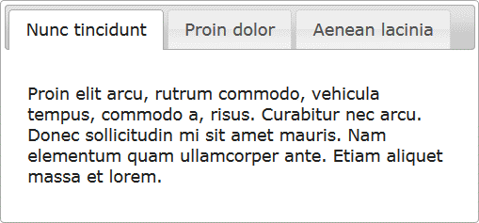
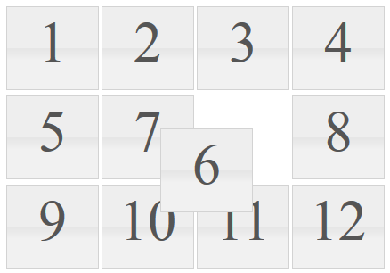
jQuery Plugins
jQuery has many ready-to-use plugins
E.g. the jQueryUI library for UI controls
Plugins for UI
Tabs
Arrangeable elements (with drag and drop)
$('#tabs-holder').tabs();
$('#grid').sortable();

Slide 6
jQuery Plugins
Live Demo

Slide 7
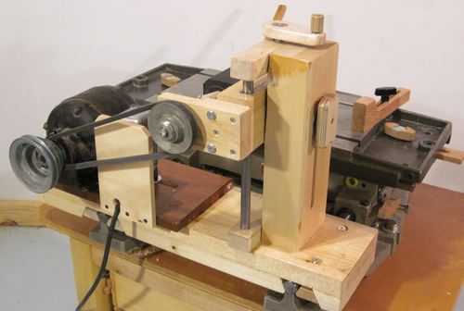
Creating Custom jQuery Plugins

Slide 8
Creating jQuery Plugins
jQuery has an easy way to extend the functionality with plugins
Create a regular JavaScript method and attach it to jQuery.fn object
(function($){
$.fn.zoom = function() {
var $this = $(this);
$this.on("mouseover", function() {
// zoom in element
});
$this.on("mouseout", function() {
// zoom out element
});
}
}(jQuery));
$(".image").zoom();

Slide 9

Zoom Plugin
Live Demo

Slide 10
Chaining in Plugins
Chaining is pretty good and useful feature
Better to be implemented in our plugins
Easy: just return this at the end of the plugin function
(function($) {
$.fn.zoom = function() {
var $this = $(this);
$this.on('mouseover', function() {…});
$this.on('mouseout', function() {…});
return $this;
}
}(jQuery));
$('.image')
.zoom()
.addClass('zoom');

Slide 11
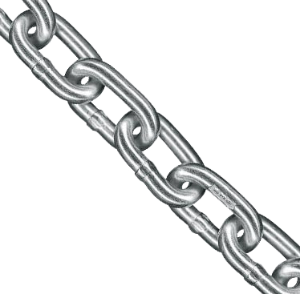
Chaining in Plugins
Live Demo

Slide 12

jQuery Plugins with Options
Making Plugins More Customizable

Slide 13
Plugins with Options
Plugins can also be provided with options
Just pass regular function parameters
(function($){
//zoom with size percents
$.fn.zoom = function(size){
var $this = $(this);
$this.on('mouseover', function() { … });
$this.on('mouseout', function() { … });
return $this;
}
}(jQuery));

Slide 14
jQuery Plugins with Options
Live Demo

Slide 15
Plugins Options
Yet the options sometimes become too many
When too many arguments, just use a options object
Give the options as a JSON-like object
(function($){
$.fn.zoom = function(options) {
var size = options.size || 5;
var $this = $(this);
$this.on('mouseover', function() { … });
$this.on('mouseout', function() { … });
return $this;
}
}(jQuery));

Slide 16
Plugins with Options Object
Live Demo

Slide 17







jQuery Plugins
https://softuni.bg/courses/javascript-applications/

Slide 18
License
This course (slides, examples, demos, videos, homework, etc.) is licensed under the "Creative Commons Attribution-NonCommercial-ShareAlike 4.0 International" license
Attribution: this work may contain portions from
"JavaScript Applications" course by Telerik Academy under CC-BY-NC-SA license

Slide 19





Free Trainings @ Software University
Software University Foundation – softuni.org
Software University – High-Quality Education, Profession and Job for Software Developers
softuni.bg
Software University @ Facebook
facebook.com/SoftwareUniversity
Software University @ YouTube
youtube.com/SoftwareUniversity
Software University Forums – forum.softuni.bg

